Slide 1


Algorithms and Data Structure

Slide 2
Topics for the week
Efficiency of algorithms
Big O
Classic Algorithms
Sorting
Searching
Recursion
Data Structures
Java collection framework
ArrayList
LinkedList
Binary Tree
Hash Table/Hash map
Binary Search Tree
Tree map

Slide 3
Day 1 Monday
Efficiency of algorithms
Big O
Insertion/Selection/Bubble sorts
Binary search
Data Structures
Introduction to Java collection framework
ArrayList
LinkedList

Slide 4
Efficiency of algorithms
Think about fundamental operations computer does
Access
Insert
Delete
Find/Search
Sort
Notes:
To measure the efficiency of algorithms, We calculate their time
and space complexity.
The notation for that is big-O, or order of growth:
O(order)
Comparison
Memory requirements
Execution time
absolute
relative (”time complexity”, ”growth rate”)
Ex
Linear search, Binary Search
worst, best, average
Big-O notation

Slide 5
Efficiency of algorithms
What are the complexities in achieving those operations?
Time
Money/Space
Ideal?
Big O - means the running time of the algorithm grows in proportion to "something"
Notes:
What computer resources that are required
Time and Size(memory) with cheaper Ram etc.. Memory Is not that important anymore like it used to be
Time is expensive so we want something that takes least amount of time

Slide 6
What is the time complexity?
public static int sumOfThreeNum (int x, int y, int z ) {
int sum = 0;
sum = x + y +z ;
return sum ;
}
Total unit of time = O(C1 + C2 + C3) = O(C)
Notes:
int sumOfarray (int [] list ) { // time units
int total = 0; // 1
for (int i = 0; i < list . length ; i ++) // 2*n
total = total + list [i]; // 2*n
return total ; // 1
}
Why we need to not take 2 and 4 constant into consideration

Slide 7
What is the time complexity?
public static int sumOfarray (int [] list ) {
int total = 0;
for (int i = 0; i < list . length ; i ++)
total = total + list [i];
return total ;
}
Total unit of time = O(1 + 2n + 2n + 1) = O(2 + 4n) = O(n)
Notes:
int sumOfarray (int [] list ) { // time units
int total = 0; // 1
for (int i = 0; i < list . length ; i ++) // 2*n
total = total + list [i]; // 2*n
return total ; // 1
}
Why we need to not take 2 and 4 constant into consideration

Slide 8
ThreeSum example
public static nt count (int [] a) {
int n = a. lenght ;
int count = 0;
for (int i = 0; i < n; i++)
for (int j = i + 1; j < n; j ++)
for ( int k = j + 1; k < n; k ++)
if (a[i] + a[j] + a[k] == 0)
count ++
return count ;
}
Total unit of time = ?
Notes:
What is the time complexity?

Slide 9
public static Comparable linearSearch (Comparable[] list,
Comparable target)
{
int index = 0;
boolean found = false;
while (!found && index < list.length)
{
if (list[index].equals(target))
found = true;
else
index++;
}
if (found)
return list[index];
else
return null;
}
Notes:
Big O (N)

Slide 10
Logarithms
How many times can we half N before we only have 1
Log₂ - logarithm function with base 2
The inverse function to the exponential function with base 2:
f(x) = 2^{x}
Log₂
How does it look - graphically?
O(n) < O(n.logn) < O(n^2)
Notes:
Let us understand this with the help of simple loops:—
i=1;i=1;
while(i<=n)while(i<=n)
{{
x=y+z;x=y+z;
i=2∗i;i=2∗i;
}}
Here time complexity is O(logn) with base 2.
i=1;i=1;
while(i<=n)while(i<=n)
{{
x=y+z;x=y+z;
i=6∗i;i=6∗i;
}}
Here time complexity is O(logn) with base 6.

Slide 11
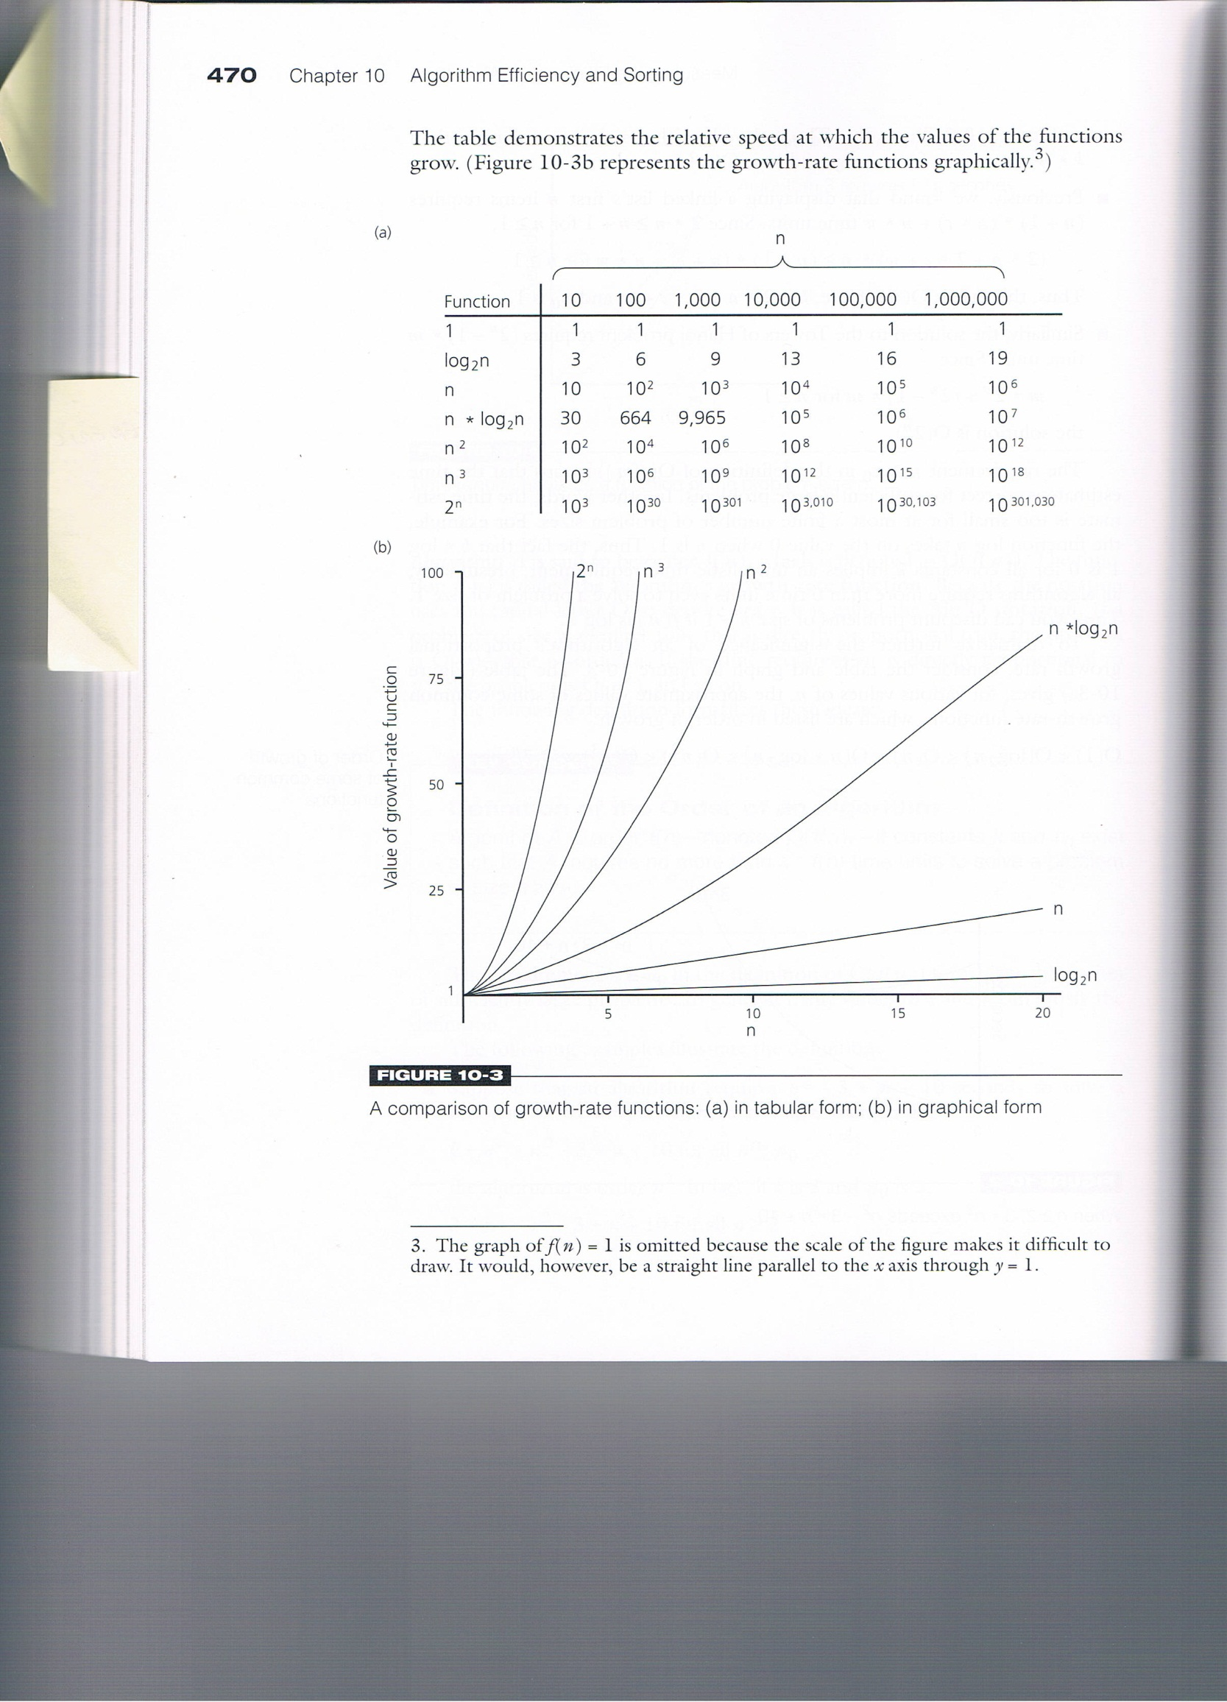

Slide 13
public static void selectionSort (Comparable[] list)
{
int min;
Comparable temp;
for (int index = 0; index < list.length-1; index++)
{
min = index;
for (int scan = index+1; scan < list.length; scan++)
if (list[scan].compareTo(list[min]) < 0)
min = scan;
// Swap the values
temp = list[min];
list[min] = list[index];
list[index] = temp;
}
}

Slide 14
Comparable <T> : Comparing objects
Used widely for sorting objects in data structures
int compareTo(T obj)- compare this object with obj, which is type T. It returns a negaive integer, zero or positive when this object is less than, equal, or greater obj
ObjectA.compareTo(ObjectB)
ObjectA | Less than | ObjectB | Negative Integer
ObjectA | Equal | ObjectB | Zero
ObjectA | Greater than | ObjectB | Positive Integer
Notes:
https://docs.oracle.com/javase/8/docs/api/java/lang/Comparable.html -
https://www.youtube.com/watch?v=B51Y0ROVmos

Slide 15
Comparable and Comparator Interfaces
Objects which implement Comparable in java can be used as keys in a TreeMap/TreeSet without implementing any other interface.
Using Comparator interface, we can write different sorting based on different attributes of objects to be sorted.

Slide 16
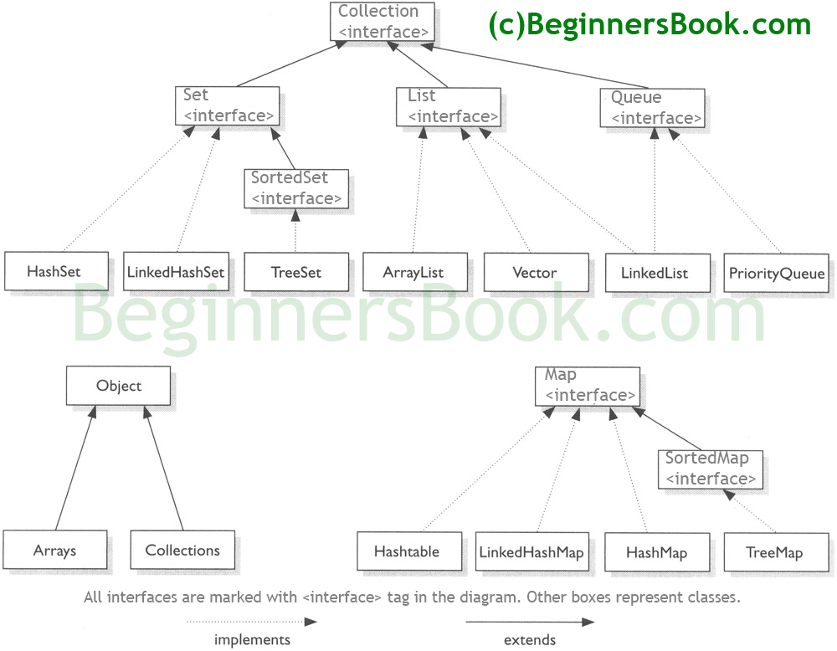
Java Collection Framework

Slide 17
Classic algorithms for manipulating a list
Linear search: O(n)
Binary search: O(log n)
Selection Sort: O(n²) (same for Insertion and Bubble Sort)
Quick Sort: O(n*log n) (average) O(n²) (worst)

Slide 18
Resources

